Slide 1
CHAPTER 8
FIGURE 8.8 EXPLANATION

Slide 2
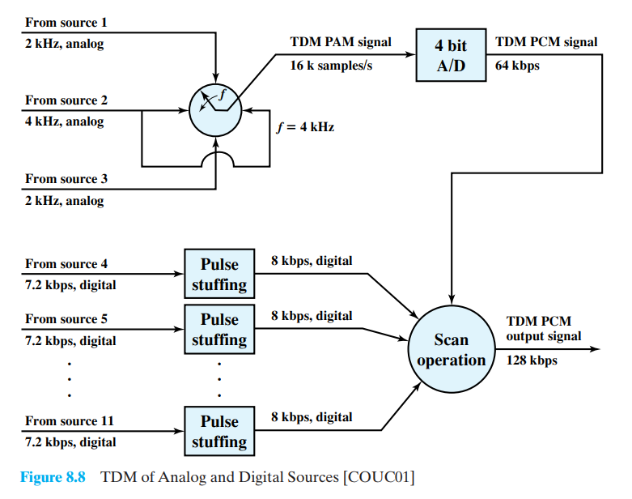
FIGURE 8.8

Slide 3
SECTIONS

Slide 4
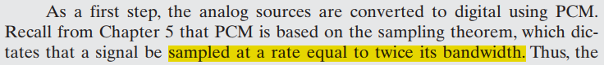
PAM Analog Samples
3 Analog Channels.
Source 2 is reused.
Sample rate:
S1 = 4k (samples/s).
S2 = 8k (samples/s).
S3 = 4k (samples/s).

Slide 5
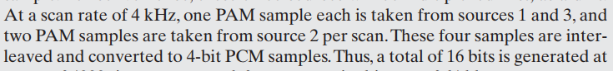
PAM Analog Samples
1
Counter-clockwise.
Scan rate = 4k Hz.
4k samples/scan.
Total: 16k samples
1
2
3
2
2
2
3

Slide 6
SECTIONS

Slide 7
Analog To Digital Converter
Quantized first.
Binary and digital encoding.
4 bits/sample.

Slide 8
Analog To Digital Converter
Total: 64 kbps.
4 bits/sample

Slide 9
SECTIONS

Slide 10
Digital Inputs
8 Digital Inputs.
Data rate = 7.2 kbps.

Slide 11
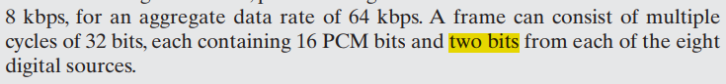
Digital Inputs
Pulse stuffing technique.
2 dummy bits extra.
Inserted at fixed locations.
Raise each source.

Slide 12
Digital Inputs
Total: 64 kbps.

Slide 13
SECTIONS

Slide 14
Scan Operation
Digital signal (from PCM): 64 kbps.
Digital signal (from Input): 64 kbps.

Slide 15
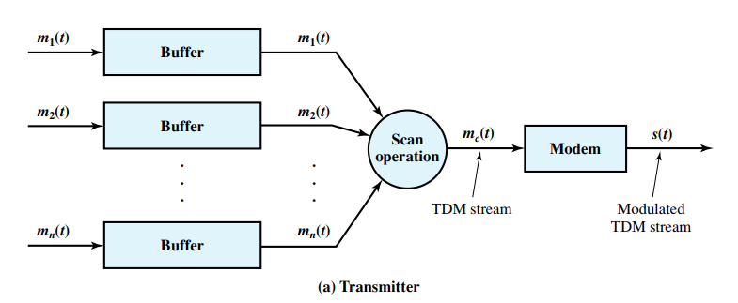
Scan Operation

Slide 16
Scan Operation
Digital signal (from PCM): 64 kbps.
Digital signal (from Input): 64 kbps.
Output signal: 128 kbps.
64 + 64 ≥ 128

Slide 17
THANKS FOR LISTENING !

